Slide 1
MICROBIOLOGY, PARASITOLOGY & IMMUNOLOGY

Slide 2
MICROBIOLOGY
Objectives
Explain concepts of infection
Describe Sources of microorganisms
Describe Modes of transmission
Describe the Classification of microorganisms and clinical importance

Slide 3
Introduction
Def:
Microbiology
is the study of living organisms/microbes of microscopic size that cause infection.
It is the study of the structure, body functions and physiological processes of microorganism
The process of microbial inversion of the body is called infection.

Slide 4
Terminologies
Binary fission
Capsule
aerobe
Facultative anaerobe
Genus
Saprophytic
Spores
Opportunistic

Slide 5
Historical dev’t of micro B
Some of the pioneers who are credited for the development of microB include:
Antony Van Leeuwenhock (1675), the dutch scientist who was the first person to see micro-organism using a microscope. He was the first man to build a microscope. He is credited for coming up with a bacteria drawing that we see today.
In 1796 Edward Jenner showed that small pox could be prevented by inoculation with cowpox.

Slide 6
Cont’d
Louis Pasteur (1864-1888)
Is credited for the development of modern microbiology. He demonstrated that fermentation was caused by growth of microorganisms.
Robert Koch (1877)
Described easy methods for bacteriological exams and also devised simple methods for isolating bacteria.

Slide 7
Cont’d
Pasteur's work led to an effective sterilization method
He developed vaccines for diseases; anthrax, fowl cholera and rabies
Beginning with Pasteur’s work, discoveries included the relationship between microbes and disease, immunity, and antimicrobial drugs
He postulated the Germ Theory of Disease which states that microorganisms are the causes of infectious diseases

Slide 8
For an organism to be said to have caused a particular disease then;
The micro-organism must be found in all cases of disease
The micro-organism must be able to be cultured outside the body for several generations
The micro-organism must reproduce a disease on inoculation into susceptible animals
The antibody to the organism develops during the course of infection

Slide 9
Assignment
Explain Anthony van Leuweenhoeks contribution to the discovery of microorganisms.
How did Louis Pasteur defeat the theory of spontaneous generation

Slide 10
Importance of micro-organisms to man
They cause decaying which is essential for the organic cycle
Causes disease to both plant and animals
Used in fermentation

Slide 11
cont
A Medical microbiologist studies the following:
characteristics of pathogens ( micro-organisms that causes disease).
Their modes of disease transmission
Mechanisms of transmission of infections
Their growth and development .

Slide 12
Categories of infectious agents:
Bacteria
Viruses
Fungi
Parasites (protozoa)

Slide 13
Importance of medical microbiology
1.Health risks can be identified and prevented.
2. Monitoring of virulent or resistant strains of microbes and instituting relevant interventions.
3. Educating the community and helping in designing of good health practices.
4. Preventing or controlling epidemics and outbreaks of diseases.
5. Development of antibiotics and other treatment methods.
6.Microorganisms found in the body as normal flora prevents potential pathogens from gaining access to our body, help in processes such as digestion, production of Vitamin K and B

Slide 14
cont
7.Industrial processes such as fermentation e.g breweries, wastewater treatment and preservation are related to microorganisms. Production of various food products; cheese, pickles, sauerkraut, green olives, yoghurt, soy sauce, vinegar, bread, Beer, Wine, Alcohol
8.In agriculture – plant microorganisms, animal microorganisms, soil microorganisms applied in agro and veterinary medicine
Using bacteria to control the growth of insects e.g Bacillus thuringiensis to control caterpillars, bollworms, corn borers
9.Cause biodegradation of wastes, Bacteria are primary decomposers - recycle nutrients back into the environment (sewage treatment plants)
10.Form part of food chain

Slide 15
Significance of microbiology to nurses
Knowledge of microbiology and infection prevention and control provides nurses with the skills and knowledge to prevent the transmission of pathogens in health care setting .
Student nurses will gain knowledge of the most important bacteria ,fungal ,parasitic and viral infections .
It enables nurses to establish and maintain a sterile field (environment )free from pathogens.
Nurses will gain knowledge of putting on personal protection to prevent the transmission of pathogens.
It enables nurses gain knowledge on the roles of the immune system in the defense of the human body against disease-causing organisms.

Slide 16
Sources of microorganisms
1. Airborne organisms: may fall onto fruits and vegetables, then penetrate the product through abrasion of the skin. 2. Crops carry soil borne bacteria to the processing plant( eg horticultural crops -vegetables, fruits). 3. Shellfish concentrate organisms by straining contaminated water in their filtering apparatus. 4. Rodents and arthropods transport micro organisms on their feet and body parts as they move about foods

Slide 17
cont
5. Contaminated water- through washing of vegetables and other food types. 6. Human handling of foods also provides a source of contamination – Careless butcher can transmit bacteria from animal intestines – Food handlers in salad bars( raw vegetables) • Hepatitis A • Typhoid • Cholera

Slide 18
Routes of transmission
The spreading of microbes is called transmission.
Transmission involves the following stages:
Escape from the host or reservoir of infection (where the infectious agent normally lives and multiplies).
Transport to the new host.
Entry to the new host.
Escape from the new host.

Slide 19
The main routes of transmission are:-
Person to person transmission through contact
Contaminated blood and other body fluids eg hepatitis B and HIV during sexual intercourse and use of contaminated needles
Saliva eg infections spread through kissing like common cold and flu
Air eg Measles, mumps and tuberculosis can be spread by coughing or sneezing.
A cough or a sneeze can release millions of microbes into the air in droplets of mucus or saliva which can then infect somebody else if they breathe in the infected particles.

Slide 20
cont
4. ingestion of contaminated food
Insects can also transmit pathogens to food. House flies are very good at spreading Salmonella and E.coli O157.
They feed on faecal waste and transfer microbes from their feet and other body parts to food
Microbes can be spread from one food to another during the preparation process, for example by unclean hands, or dirty kitchen utensils, and cause illness when those foods are eaten.
This is known as cross-contamination

Slide 21
cont
6. Water-Some diseases are caused by drinking water that is contaminated by human or animal faeces, which may contain disease-causing microbes.
Clean water, hygiene and good sewerage systems prevent the spread of water-borne diseases such as typhoid and cholera.

Slide 22
cont
7. Insects
Insects are responsible for spreading many diseases.
Malaria is spread from person to person by certain species of female mosquito carrying the protozoan Plasmodium falciparum.
Bubonic plague (Black Death) is a bacterial disease of rodents caused by Yersinia pestis.
It can be spread to humans and other animals by infected rat fleas.

Slide 23
cont
8. Fomites
This is a non-living object such as bedding, towels, toys and barbed wire that can carry disease-causing organisms.
Eg The fungus Trichophyton that causes athlete’s foot can be spread indirectly through towels and changing room floors

Slide 24
Bacteria
Are unicellular/single celled organisms
They lack membrane bound nucleus and organelles.
Double stranded DNA lies loose in the cytoplasm with arigid peptidoglycan cell wall
Divide by binary fission
Some are harmful while others are beneficial to man

Slide 25
viruses
Smaller than bacteria
Contain either DNA or RNA as agenome

Slide 26
Fungi
Are eukaryotic with rigid cell wall
May replicate asexually or sexually
They form spore like structure
Parasites
Comprise of worms, malaria parasite etc

Slide 27
1. Bacteriology
This is the study of bacteria.
Bacteria is a minute unicellular organism.
Has rigid peptidoglycan cell-wall and divides by binary fission

Slide 28
Cont’d
Bacteria are characterized based on
structure cell arrangement
size
the cell shape
staining reactions
motility
flagella arrangement.

Slide 29
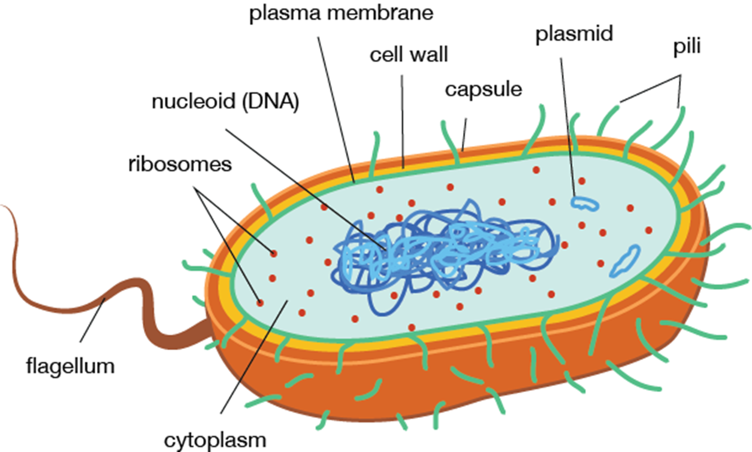
Bacteria structure

Slide 30
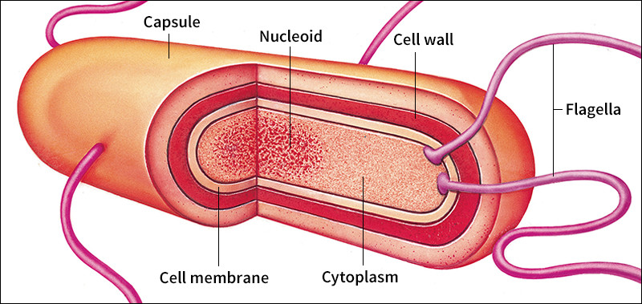
Cont’d

Slide 31
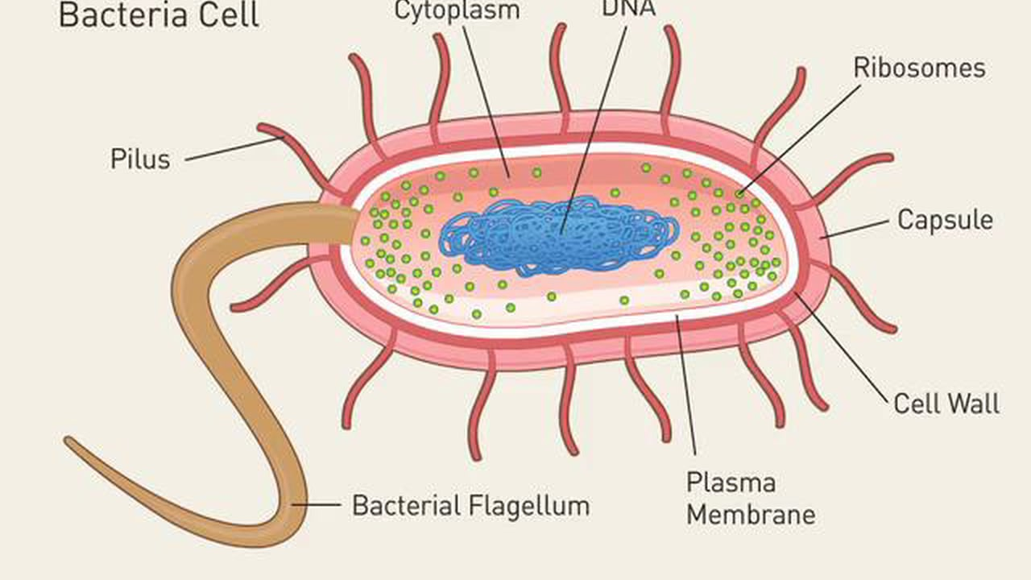
Cont’d

Slide 32
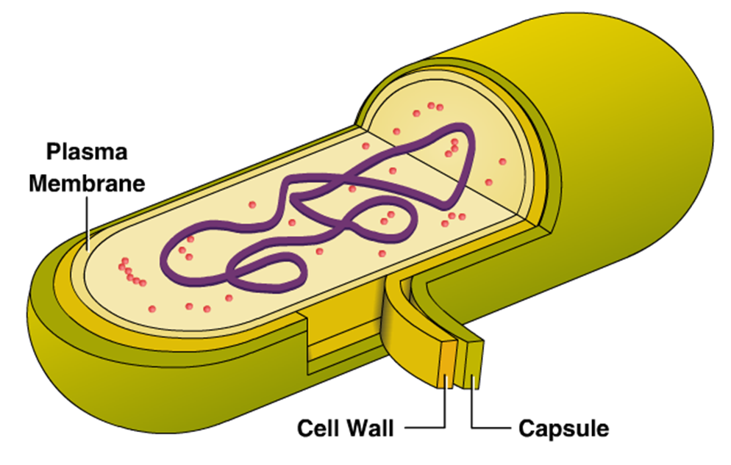
Cont’d

Slide 33
Cont’d
Capsule
Is amorphous material which forms the outermost layer of bacteria
Composed of polysaccharide and proteins
It inhibits phagocytosis and hence correlates with bacterial virulence
Cell wall
Tough rigid structure strengthened by peptidoglycan layers.
Protects the bacteria against osmotic changes.

Slide 34
Cont’d
Differences in composition of bacterial cellwall leads to differences in the staining of bacteria, thus Gram +Ve and Gram –Ve bacteria.
Gram +ve thick wall, large amount of peptidoglycan (purple)
Gram –ve thin wall, small amount of peptidoglycan (red/pink)
Cytoplasmic membrane
Is a selective barrier, semipermeable membrane controlling water, nutrients, ions, electrolytes movement in and out of bacteria.
Also site for enzymes involved in active transport of nutrients and other metabolic processes

Slide 35
Cont’d
Mesosome
Are convoluted invaginations of cytoplasmic membrane
Site for septum formation and involved in DNA segregation during cell division
Nuclear material/nucleuos- for replication of DNA and RNA
Ribosomes- site for protein synthesis
Flagella- long filaments structures for bacterial motility

Slide 36
Cont’d
Function of Flagella
Bacterial propel themselves by rotating their helical flagella.
Based on their location on the cell, flagella may be polar or lateral.
(i) Polar: At one or both ends of bacterium.
(ii) Lateral: Along the sides of the bacterium.

Slide 37
Types of flagella
Monotrichous: A single polar flagellum.
Many that appears and function as monopolar or bipolar flagella consists of bundles of 2 to 50 single units (polytrichous).
* Lophotrichous: A cluster of polar flagella.
* Amphitrichous: Flagella, either single or clusters at both cell poles.
* Peritrichous: Cell surrounded by lateral flagella.

Slide 38
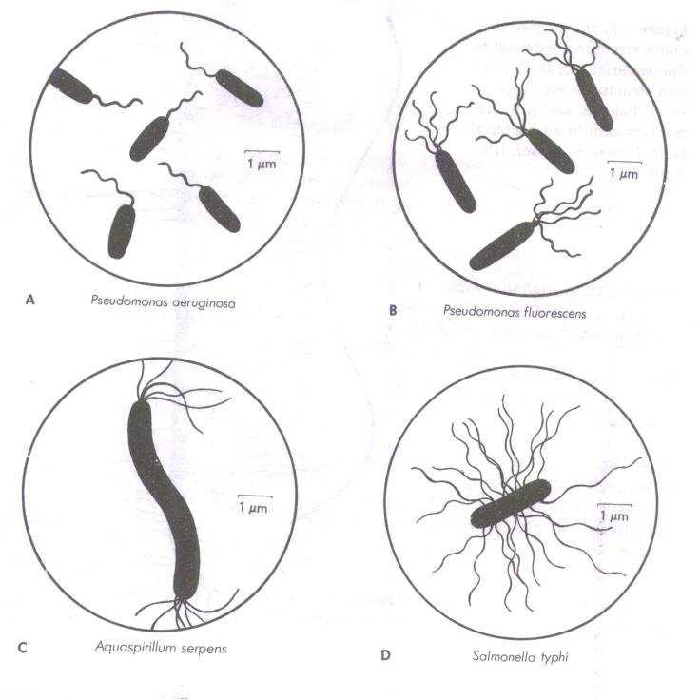
Cont’d

Slide 39
Size
Bacteria are very small, 0.5 to 1.0 NM in diameter.
Because of their small size they have high surface area/volume ratio which results in a high growth and metabolism rate.

Slide 40
Classification of bacteria
Bacteria classification is based on;
Morphology
Biochemical characteristics
Lab identification
Growth requirement/cultural characteristics

Slide 41
1. Morphological
Spherical-cocci eg S. pneumonia
Cylindrical-bacilli or rods
Helical- spirochaetes, flexible,coiled and motile e.g Trepanoma pallidum
Vibrios-coma like

Slide 42
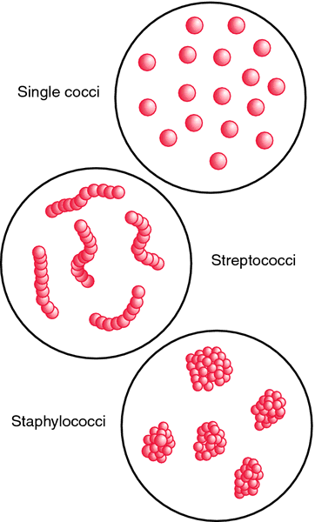
cont

Slide 43
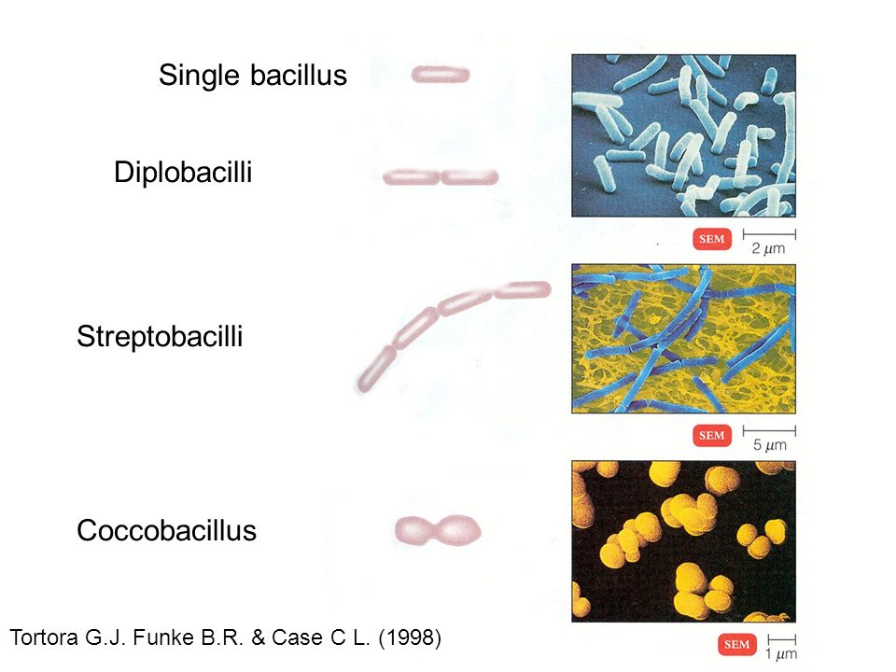
Cont’d

Slide 44
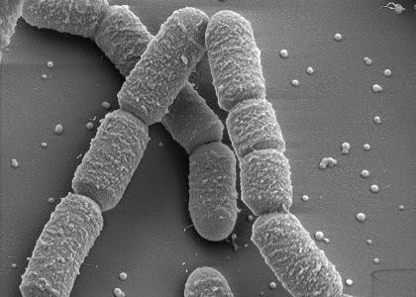
Cont’d

Slide 45
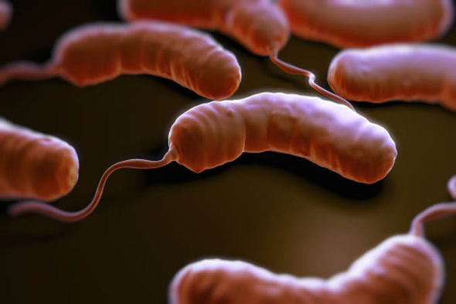
vibrios

Slide 46
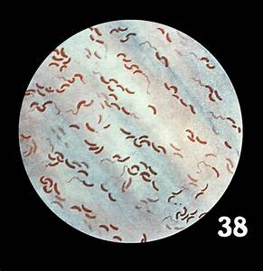
Vibrios

Slide 47
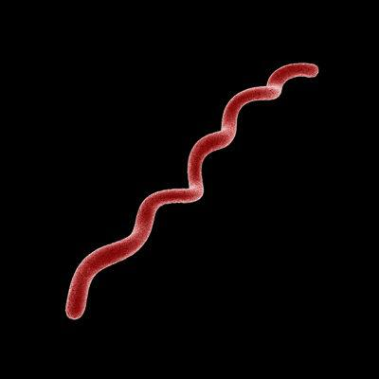
spirilla

Slide 48
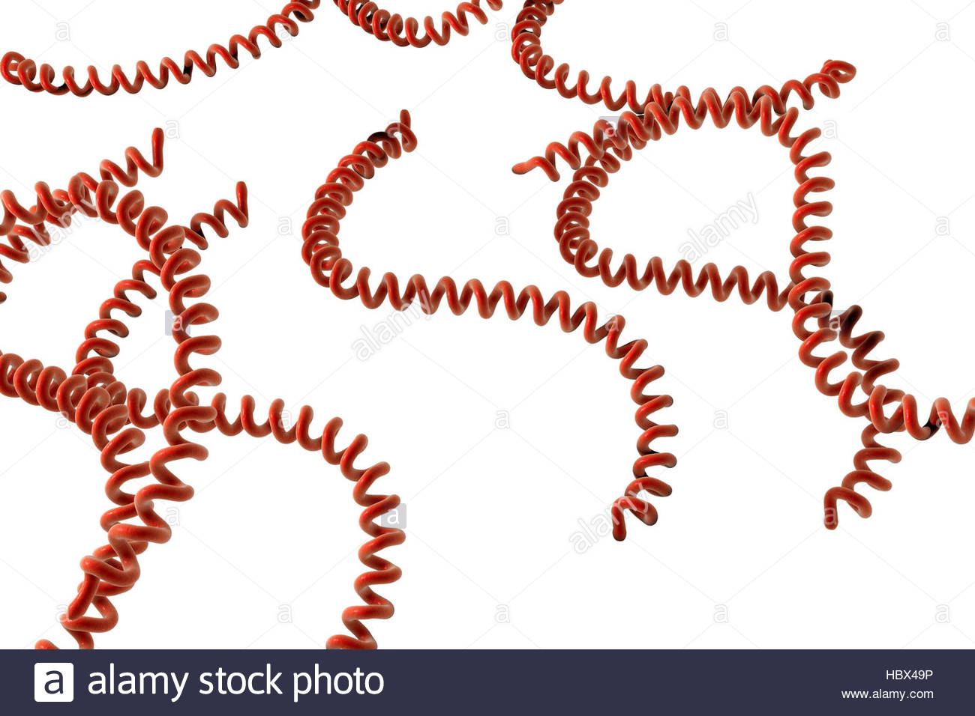
Spirochetes

Slide 49
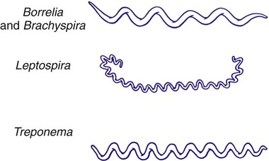
Cont’d

Slide 50
2. biochemical
Coagulase-the enzyme that clots/coagulates plasma and fibrin
Hyalurodinase-breaks hyaluronic acid the cement of connective tissue, causing increased permeability
Production of toxin-exotoxins and endotoxins

Slide 51
3. Lab identification
Gram staining
Giemsa staining-histopathological diagnosis of malaria and other parasites
Elisa (HIV) Ziehl Neelsen test- for acid fast bacilli eg mycobacteria AFB
Urinalysis- E. coli
CSF analysis
Field staining for malaria parasite

Slide 52
4. Growth requirement/cultural characteristics.
Binary fission
Generation time
Phases of growth

Slide 53
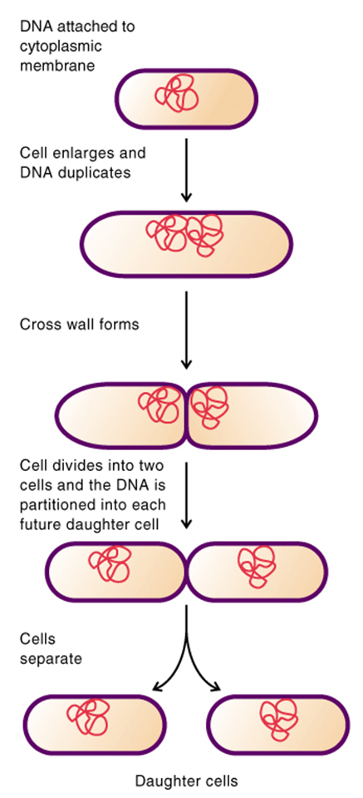
Binary fission
Prokaryote cells grow by increasing in cell number (as opposed to increasing in size).
Replication is by binary fission, the splitting of one cell into two
Therefore, bacterial populations increase by a factor of two (double) every generation time.

Slide 54
Generation time
The time required to for a population to double (doubling time) in number. eg
Ex. Escherichia coli (E. coli) double every 20 minutes
Ex. Mycobacterium tuberculosis double every 12 to 24 hours

Slide 55
Growth in Batch Culture
Bacteria growing in batch culture produce a growth curve with up to four distinct phases.
Batch cultures are grown in tubes or flasks and are closed systems where no fresh nutrients are added or waste products removed

Slide 56
Phases of growth
Lag phase occurs when bacteria are adjusting to them medium. For example, with a nutritionally poor medium, several anabolic pathways need to be turned on, resulting in a lag before active growth begins.
In log or exponential phase, the cells are growing as fast as they can, limited only by growth conditions and genetic potential. During this phase, almost all cells are alive, they are most nearly identical, and they are most affected by outside influences like disinfectants.

Slide 57
CONT’D
Due to nutrient depletion and/or accumulation of toxic end products, replication stops and cells enter a stationary phase where there is no net change in cell number.
Death phase occurs when cells can no longer maintain viability and numbers decrease as a proportion.

Slide 58
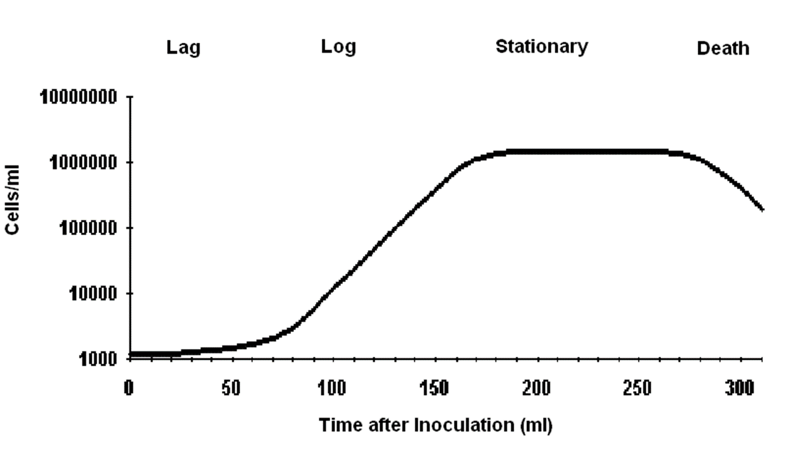
Growth curve

Slide 59
Environmental factors
Temperature
Oxygen requirement
Ph
Water availability

Slide 60
Bacteria classification
ASSIGNMENT!!!!!!!!!!!
Gram +ve Bacteria
Gram –ve bacteria

Slide 61
concept of infection
Objectives
By the end of this session, the learner will be
able to:
Describe the stages of development of an infection
Define various terms related to infection
Describe the phases of an infectious d’se

Slide 62
Infection
is invasion by and multiplication of
pathogenic microorganisms in a body
part or tissue
This invasion may produce subsequent
tissue injury and progress to disease
through a variety of toxic mechanisms.

Slide 63
Stages in development of infection
Acquisition
Adhesion to host cells
Penetration of cells
Multiplication in tissues
Damage to tissues
Spread to other tissues
Resolution or death

Slide 64
1. Acquisition, Adhesion & Penetration
The microorganism must adhere to the cell, then penetrate it.
The microbe may use various methods to:
Special hairs on their surface,
Fimbriae (thin appendages used in attachment) or Pilli (thin appendages used in genetic exchange),
Secrete sticky substances (e.g. dextran)
Produce slime. (e.g. biofilm)

Slide 65
4. Multiplication in the host
The microbe multiplies in the host cell & overpowers the host’s defenses so as to cause disease.
The virus has the ability to switch the metabolism of the cell to the production of viral components.

Slide 66
5. Tissue damage
Pathogenic microorganisms cause disease by damaging the host’s tissue.
Damage occurs due to release of enzymes or substances that destroy cells or tissues in the local area.

Slide 67
6. Spread to other tissues
Some infections remain at the site of invasion, causing symptoms related to invasion of epithelial tissue at the particular site.(e.g. Shigella invades the GIT)
Some microorganisms spread once they have been established in a particular site. (e.g. salmonella typhi establishes itself in the GIT, then spreads through blood and causes fever)

Slide 68
7. Resolution or death
The function of the cell may be disrupted
OR the cell may be destroyed when new microbes are released.
The effects depend on the particular microbe and the location of the infected cells. (e.g. Polio virus infects motor neuron cells and shuts down protein synthesis causing the death of neurons and paralysis of the muscles that they innervate)

Slide 69
Resolution or death cont..
The infection may resolve (death of the pathogen) due to;
Improved host defenses
Antibiotic therapy

Slide 70
Definitions related to infection

Slide 71
Pathogenicity
Pathogens are microbial species that invade and damage tissue to cause disease.
Pathogenicity is the capacity of microorganism to cause disease.

Slide 72
Pathogenicity cont’d….
Some microorganisms cause a single disease (e.g. clostridium tetani-tetanus)
Others cause a range of diseases:
e.g. Staphylococcus aureus can cause: skin infections, wound infection, pneumonia and Osteomyelitis.

Slide 73
Pathogenicity cont’d….
Some pathogens cause infections that become severe in debilitated people.
Opportunistic pathogens cause disease in individuals with impaired defenses.
(e.g. Pneumocystis carinii, a normal flora in healthy people but causes PCP in immune-compromised people)

Slide 74
Primary vs.Secondary Infection
Primary Infection
An infection that develops in an otherwise healthy individual
Secondary Infection
An infection that develops in an individual who is already infected with a different pathogen

Slide 75
Acute Vs. Chronic Infection
Acute Infection
An infection characterized by sudden onset, rapid progression, and often with severe symptoms
Chronic Infection
An infection characterized by delayed onset and slow progression

Slide 76
Localized vs. systemic infection
Localized Infection
An infection that is restricted to a specific location or region within the body of the host
Systemic Infection
An infection that has spread to several regions or areas in the body of the host

Slide 77
Clinical vs. subclinical infection
Clinical Infection
An infection with obvious observable or detectable symptoms
Subclinical Infection
An infection with few or no obvious symptoms

Slide 78
Opportunistic infection
An infection caused by microorganisms that are commonly found in the host’s environment (normal flora)

Slide 79
Nosocomial Infections
Also called Hospital Acquired Infections (HAI’s)
Infection which was neither present nor incubating at the time of admission
Infection that appears between 48 hours & 4 days following admission to a hospital or other health-care facility.

Slide 80
PARASITOLOGY
OBJECTIVES
Definition of terms
Explain the Sources of parasites
Describe the Modes of transmission
Describe the Classification of parasites
Describe the Life cycle and clinical importance of parasites

Slide 81
INTRODUCTION
It is the study of parasites
A parasite is a living organism, which takes its nourishment and other needs from a host
the host is an organism which supports the parasite.

Slide 82
. DIFFERENT KINDS OF PARASITES
Ectoparasite – a parasitic organism that lives on the outer surface of its host, e.g. lice, ticks, mites etc.
Endoparasites – parasites that live inside the body of their host, e.g. Entamoeba histolytica.
Obligate Parasite - This parasite is completely dependent on the host during a segment or all of its life cycle, e.g. Plasmodium spp.
Facultative parasite – an organism that exhibits both parasitic and non-parasitic modes of living and hence does not absolutely depend on the parasitic way of life, but is capable of adapting to it if placed on a host. E.g. Naegleria fowleri
Accidental parasite – when a parasite attacks an unnatural host and survives. E.g. Hymenolepis diminuta (rat tapeworm)
Erratic parasite - is one that wanders in to an organ in which it is not usually found. E.g. Entamoeba histolytica in the liver or lung of humans.

Slide 83
DIFFERENT KINDS OF HOSTS
Definitive host – a host that harbors a parasite in the adult stage or where the parasite undergoes a sexual method of reproduction.
Intermediate host - harbors the larval stages of the parasite or an asexual cycle of development takes place. In some cases, larval development is completed in two different intermediate hosts, referred to as first and second intermediate hosts.
• Paratenic host – a host that serves as a temporary refuge and vehicle for reaching an obligatory host, usually the definitive host, i.e. it is not necessary for the completion of the parasites life cycle.
.

Slide 84
CONT
• Reservoir host – a host that makes the parasite available for the transmission to another host and is usually not affected by the infection.
• Natural host – a host that is naturally infected with certain species of parasite.
• Accidental host – a host that is under normal circumstances not infected with the parasite

Slide 85
symbiotic relationships
Any organism that spends a portion or all of its life cycle intimately associated with another organism of a different species is considered as Symbiont (symbiote) and this relationship is called symbiosis (symbiotic relationships).

Slide 86
Types of symbiotic relationships
Mutualism - an association in which both partners are metabolically dependent upon each other and one cannot live without the help of the other; however, none of the partners suffers any harm from the association
Commensalism - an association in which the commensal takes the benefit without causing injury to the host. E.g. Most of the normal floras of the humans’ body can be considered as commensals.

Slide 87
cont
Parasitism - an association where one of the partners is harmed and the other lives at the expense of the other.

Slide 88
EFFECT OF PARASITES ON THE HOST
(a) Direct effects of the parasite on the host
Mechanical injury - may be inflicted by a parasite by means of pressure as it grows larger, e.g. Hydatid cyst causes blockage of ducts such as blood vessels producing infraction.
Deleterious effect of toxic substances- in Plasmodium falciparum production of toxic substances may cause rigors and other symptoms.
Deprivation of nutrients, fluids and metabolites -parasite may produce disease by competing with the host for nutrients.

Slide 89
b) Indirect effects of the parasite on the host:
Immunological reaction: Tissue damage may be caused by immunological response of the host, e.g. nephritic syndrome following Plasmodium infections.
Excessive proliferation of certain tissues due to invasion by some parasites can also cause tissue damage in man, e.g. fibrosis of liver after deposition of the ova of Schistosoma.

Slide 90
Prevention and control
Reduction of the source of infection- a prompt diagnosis and treatment of parasitic diseases is an important component in the prevention of dissemination.
2. Sanitary control of drinking water and food.
3. Proper waste disposal

Slide 91
cont
4. The use of insecticides and other chemicals used to control the vector population.
5. Protective clothing that would prevent vectors from resting in the surface of the body and inoculate pathogens during their blood meal.
6. Good personal hygiene.
7. Avoidance of unprotected sexual practices.

Slide 92
Classification of parasitology
Parasitology is generally classified into:
• Medical Protozoology - Deals with the study of medically important protozoa
• Medical Helminthology - Deals with the study of helminthes (worms) that affect man.
Medical Entomology - Deals with the study of arthropods which cause or transmit disease to man.

Slide 93
PROTOZOA
Protozoan parasites consist of a single "cell-like unit" which is morphologically and functionally complete and can perform all functions of life.
They are made up of a mass of protoplasm differentiated into cytoplasm and nucleoplasm.
The cytoplasm consists of an outer layer of hyaline ectoplasm and an inner voluminous granular endoplasm.
The ectoplasm functions in protection, locomotion, and ingestion of food, excretion, and respiration.

Slide 94
CONT
In the cytoplasm there are different vacuoles responsible for storage of food, digestion and excretion of waste products.
The nucleus also functions in reproduction and maintaining life.
The protozoal parasite possesses the property of being transformed from an active (trophozoite) to an inactive stage, losing its power of motility and enclosing itself within a tough wall.
The protoplasmic body thus formed is known as a cyst.
At this stage the parasite loses its power to grow and multiply.
The cyst is the resistant stage of the parasite and is also infective to the human host.

Slide 95
Reproduction
the methods of reproduction or multiplication among the parasitic protozoa are of the following types:
1. Asexual multiplication:
(a) Simple binary fission – in this process, after division of all the structures, the individual parasite divides either longitudinally or transversely into two more or less equal parts.
(b) Multiple fission or schizogony – in this process more than two individuals are produced, e.g. asexual reproduction in Plasmodia.

Slide 96
2. Sexual reproduction:
(a) Conjugation – in this process, a temporary union of two individuals occurs during which time interchange of nuclear material takes place. Later on, the two individuals separate.
(b) Syngamy – in this process, sexually differentiated cells, called gametes, unite permanently and a complete fusion of the nuclear material takes place. The resulting product is then known as a zygote.

Slide 97
CLASSIFICATION OF THE PATHOGENIC PROTOZOA:
Protozoa are divided into four types classified based on their organs of locomotion.

Slide 98
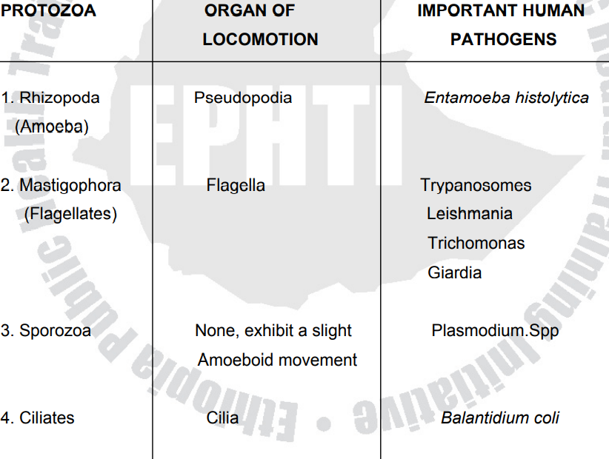

Slide 99
HELIMINTHS:
The heliminthic parasites are multicellular, bilaterally symmetrical animals having three germ layers.
The helminthes of importance to human beings are divided into three main groups

Slide 100
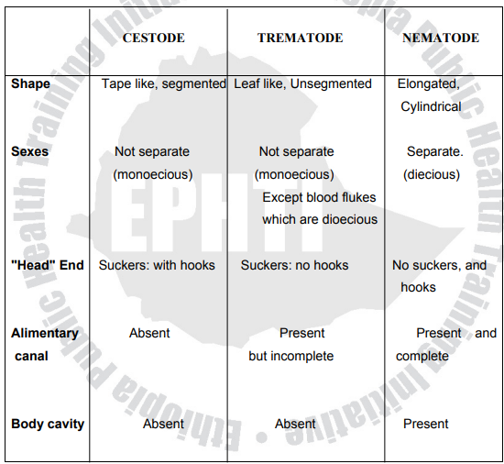

Slide 101
(3) ARTHROPODS characteristics of athropods
They have a bilaterally symmetrical and segmented body with jointed appendages.
They have a hard exoskeleton, which helps enclose and protect the muscles and other organs.
An open circulatory system, with or without a dorsally situated heart pumps the blood (hemolymph) via arteries to the various organs and body tissues.
Blood is returned to the heart through body spaces known as hemocoeles.
respiratory, excretory, and nervous systems are present.
Arthropods affect the health of humans by being either direct agents for disease or agents for disease transmission.

Slide 102
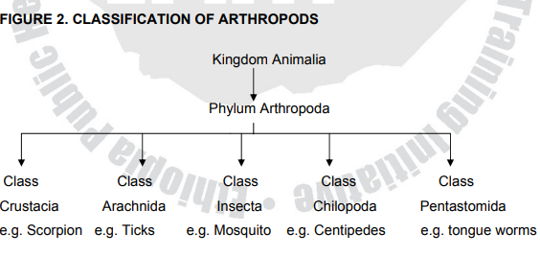

Slide 103
IMMUNOLOGY
Module objectives
Describe immunity
Discuss immunological processes and their clinical importance

Slide 104
introduction
Immunology is the study of the immune system
Our immune system is essential for our survival.
Without an immune system, our bodies would be open to attack from bacteria, viruses, parasites, and more.
It is our immune system that keeps us healthy as we drift through a sea of pathogens.
This vast network of cells and tissues is constantly on the lookout for invaders, and once an enemy is spotted, a complex attack is mounted.
The immune system is spread throughout the body and involves many types of cells, organs, proteins, and tissues.
Crucially, it can distinguish our tissue from foreign tissue — self from non-self. Dead and faulty cells are also recognized and cleared away by the immune system.

Slide 105
cont
If the immune system encounters a pathogen, for instance, a bacterium, virus, or parasite, it mounts a so-called immune response

Slide 106
Cells and organs of the immune system
White blood cells
White blood cells are also called leukocytes. They circulate in the body in blood vessels and the lymphatic vessels that parallel the veins and arteries.
White blood cells are on constant patrol and looking for pathogens.
When they find a target, they begin to multiply and send signals out to other cell types to do the same.

Slide 107
cont
white blood cells are stored in different places in the body, which are referred to as lymphoid organs.
These include the following:
Thymus — a gland between the lungs and just below the neck.
Spleen — an organ that filters the blood. It sits in the upper left of the abdomen.
Bone marrow — found in the center of the bones, it also produces red blood cells.
Lymph nodes —small glands positioned throughout the body, linked by lymphatic vessels.

Slide 108
Types of leucocytes
1. Phagocytes
These cells surround and absorb pathogens and break them down, effectively eating them. There are several types, including:
Neutrophils — these are the most common type of phagocyte and tend to attack bacteria.
Monocytes — these are the largest type and have several roles.
Macrophages — these patrol for pathogens and also remove dead and dying cells.
Mast cells — they have many jobs, including helping to heal wounds and defend against pathogens.
-

Slide 109
2. Lymphocytes
Lymphocytes help the body to remember previous invaders and recognize them if they come back to attack again.
Lymphocytes begin their life in bone marrow. Some stay in the marrow and develop into B lymphocytes (B cells), others head to the thymus and become T lymphocytes (T cells).
These two cell types have different roles:
B lymphocytes — they produce antibodies and help alert the T lymphocytes.
T lymphocytes — they destroy compromised cells in the body and help alert other leukocytes

Slide 110
The role of B lymphocytes
Once B lymphocytes spot the antigen, they begin to secrete antibodies (antigen is short for “antibody generators”).
Antibodies are special proteins that lock on to specific antigens.
Each B cell makes one specific antibody. For instance, one might make an antibody against the bacteria that cause pneumonia, and another might recognize the common cold virus.
Antibodies are part of a large family of chemicals called immunoglobulins, which play many roles in the immune response:

Slide 111
Types of immunoglobulins
1 .Immunoglobulin G (IgG) — marks microbes so other cells can recognize and deal with them.
2. IgM — is expert at killing bacteria.
3. IgA — congregates in fluids, such as tears and saliva, where it protects gateways into the body.
4. IgE — protects against parasites and is also to blame for allergies.
5. IgD — stays bound to B lymphocytes, helping them to start the immune response.

Slide 112
The role of T lymphocytes
There are distinct types of T lymphocytes:
a. Helper T cells (Th cells) — they coordinate the immune response.
Some communicate with other cells, and some stimulate B cells to produce more antibodies.
Others attract more T cells or cell-eating phagocytes.
b. Killer T cells (cytotoxic T lymphocytes) — as the name suggests, these T cells attack other cells.
They are particularly useful for fighting viruses. They work by recognizing small parts of the virus on the outside of infected cells and destroy the infected cells.

Slide 113
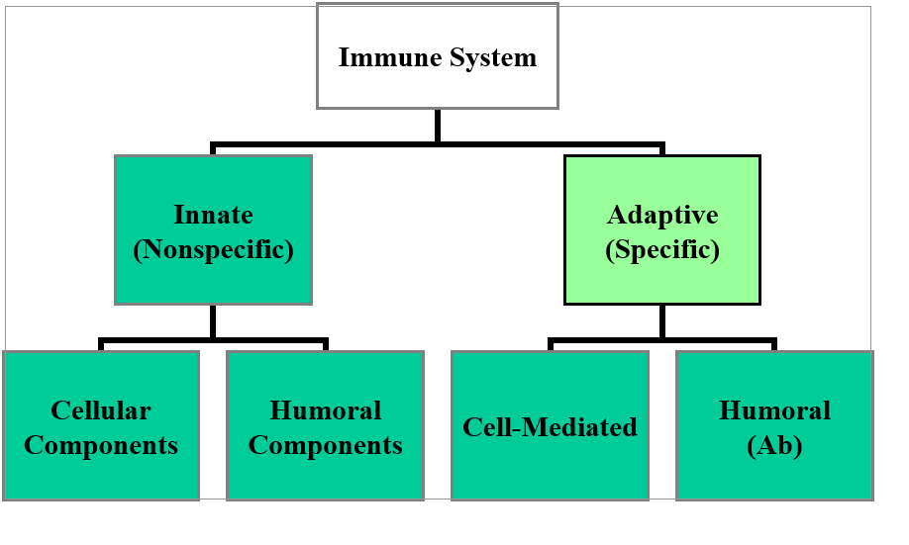
immunity

Slide 114
The Innate immunity
Natural immune system (Innate Immunity)
Non – specific
First line of defense
Repeated exposure - no augmentation
Components
Biochemical
Physical
Cells

Slide 115
Components
Biochemical
enzymes
secretions
pH
Physical
skin
cilia
Cells
Phagocytes, NK
Example
Burn response

Slide 116
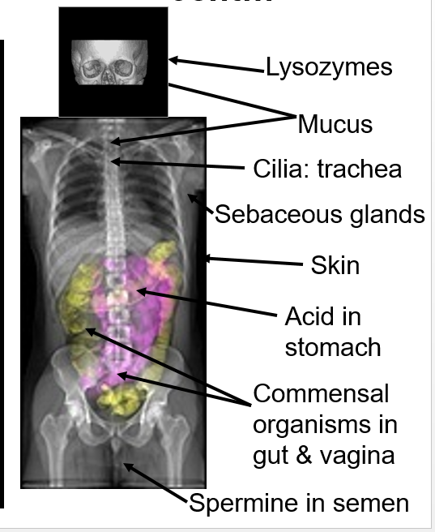

Slide 117
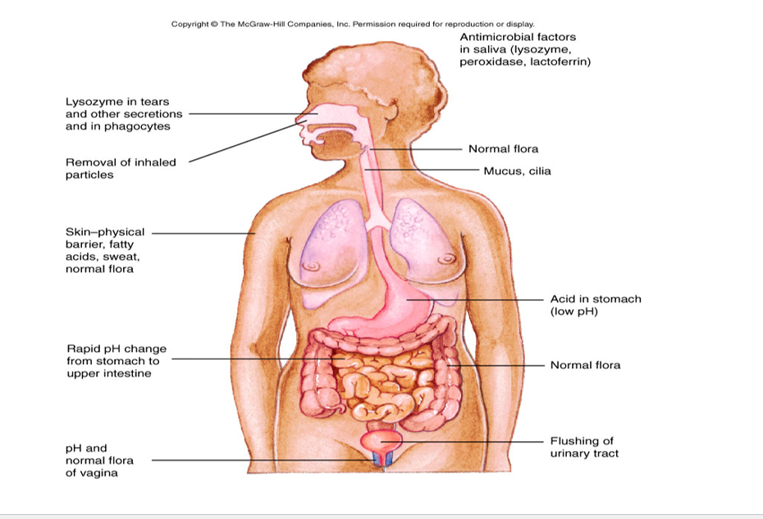

Slide 118
cont
Overall non-specific reaction of body to injury or invasion – starts immediately with infection or trauma
Reactants may initiate, expand, or sustain the response
Can be acute (short duration) or become chronic (prolonged duration)
Has 4 cardinal signs: heat, pain, redness, loss of function resulting from:

Slide 119
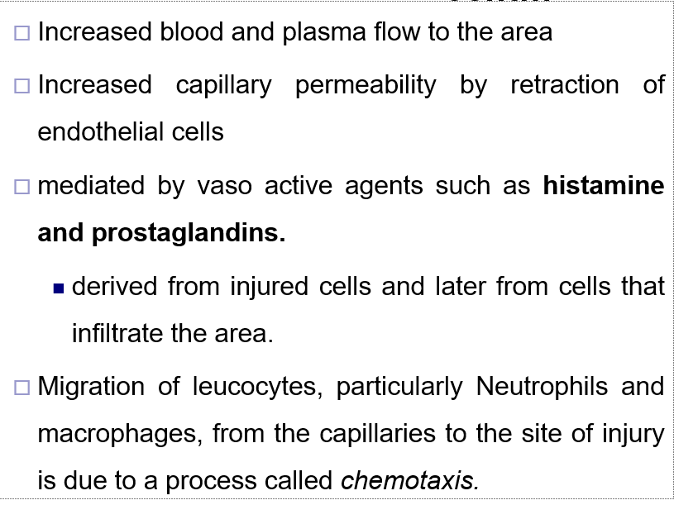

Slide 120
cont
Migration of white cells, especially early migration of neutraphils then macrophages to the area
Increased release of mediators such as histamine from damaged mast cells – furthering capillary dilation
Increased concentration of acute phase reactants that can amplify and/or control the response
Complement – a series of enzymes normally circulating in an inactive form may be activated resulting in lysis or enhanced phagocytosis of cells

Slide 121
External Innate Defense Systems
Prevent entrance:
I. Structural barriers – effective with most microorganisms
a. Skin - epidermis = layers of tightly packed epithelial cells. Outer layer is dead cells and keratin, waterproofing protein
b.Inner layer skin - dermis = blood vessels, hair follicles, sweat glands, and sebaceous glands that produce an oily secretion called sebum
c. Cilia and cough reflex – helps expel microbe containing mucous
Sneeze

Slide 122
cont
b. Mucus - conjunctivae, alimentary, respiratory, and urogenital tracts
saliva, tears, and mucous secretions wash away invaders and contain antibacterial or antiviral substances.
acidity (pH 5.6) of sweat, sebaceous glands, vagina (pH 5) and stomach (pH 1) – unfriendly to many microorganisms
enzymes present in the skin and stomach, tears
C. Normal flora - out compete pathogens for attachment sites on the epithelial cell surface and for necessary nutrients.

Slide 123
Internal Innate Defense System
To prevent expansion of penetration
Recognize carbohydrates not normally present on cells such as mannose
May cause nonspecific activation of white cells
Phagocytosis – by neutraphils, eosinophils, basophils, or macrophages, mast cells, and dendritic cells
Clotting mechanism which entraps organisms in fibrin clots
Complement System can lyse cells or enhance phagocytosis

Slide 124
Physiologic Barriers
Soluble factors contribute to innate immunity, they are collectively known as acute phase reactants.
Normal serum components, non-specific responders to inflammation
Increase because of infection, injury, trauma
Produced mostly by liver in response to inflammation and cytokine stimulation
Cytokines: IL-1, IL-6 and TNF alpha which are produced by macrophages and monocytes at inflammatory site are activators

Slide 125
cont
Complement – a series of enzymes normally circulating in an inactive form
May be activated by the classical or alternate pathways
Can result in lysis or enhanced phagocytosis of cells
Lysozyme, a hydrolytic enzyme in mucous secretions and in tears, can cleave the peptidoglycan layer of bacterial cell wall.
Interferon, proteins produced by virus-infected cells. Has many functions including ability to bind to nearby cells and induce a generalized antiviral state.

Slide 126
Phagocytosis
Phagocytosis ...
Adherence – binding of organism to the surface of phagocytic cell.
Engulfment:- is the injestion of m/os and formation of phagosomes.
Digestion – after the foreign particle is ingested, cytoplasm lysosome fuse with phagosome The enzymes of lysosome then contribute to microbial killing and lysis.

Slide 128
The adaptive immune system
. Adaptive Immunity
Specific
Second line of defense
Repeated exposure - augmented – memory
Faster response
More vigorous response
Longer lasting response
Anamnestic- rapid production of abs
Components
Classic Immune System
Cells (Cell mediated) =CMI
Soluble Factors (Humoral immunity) = HI

Slide 129
cont
Capable of recognizing and selectively eliminating specific foreign microorganisms and molecules(i.e., foreign antigens).
Unlike innate immune responses, adaptive immune responses are reactions to specific antigenic challenges
Different populations of lymphocytes and their products are the major actors together with accessory cells – Antigen presenting cells (APCs)
Cardinal features are :
Specificity
Diversity , Memory,

Slide 130
Cardinal Features of adaptive Immune Responses
1. Specificity –
specific for distinct antigen, and
for different structural components of a single complex protein, polysaccharide, or other macromolecules.
Portions of such antigens recognized by individual lymphocytes are called determinants or epitopes.
This fine specificity exists because individual lymphocyte express membrane receptors able to distinguish subtle (slight) differences in structure between distinct antigens.

Slide 131
2. Diversity
- total number of antigenic specificities of the lymphocytes in an individual, called the lymphocyte repertoire, is extremely large.
estimated mammalian immune system can discriminate 10⁹ to 10¹¹ distinct antigenic date ruminants.
This property of the lymphocyte repertoire is called diversity. It is the result of variability in the structures of antigen- binding sites of lymphocyte receptors for antigens.

Slide 132
3. Memory
- Exposure of the immune system to foreign antigen:
enhances its ability to respond again to that antigen.
Responses to second and subsequent exposure to the same antigen, called secondary immune responses, are usually more rapid and larger than the first or primary immune response

Slide 133
cont
An effective immune response involves three major groups of cells: Cellular Immunity (T lymphocytes), Humoral Immunity (B cells), and Accessory cells (antigen-presenting cells).
The two major populations of lymphocytes—B lymphocytes (B cells) of Humoral immunity and T lymphocytes (T cells) of Cellular Immunity provide us with our specific adaptive immunity

Slide 134
4. Specialization
the immune system responds in distinct and special ways to different microbes, maximizing the efficiency of antimicrobial defense mechanisms.
Thus, humoral immunity and cell mediated immunity are elicited by different classes of microbes or by the same microbe at different stages of infection (extra cellular & intra cellular)
5. Self –limitation- All normal immune responses returning the immune system to its resting or basal state with time after antigen stimulations, process called homeostasis.

Slide 135
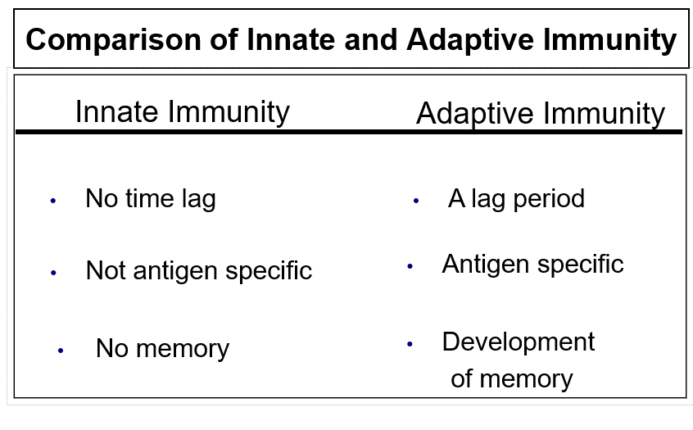

Slide 136
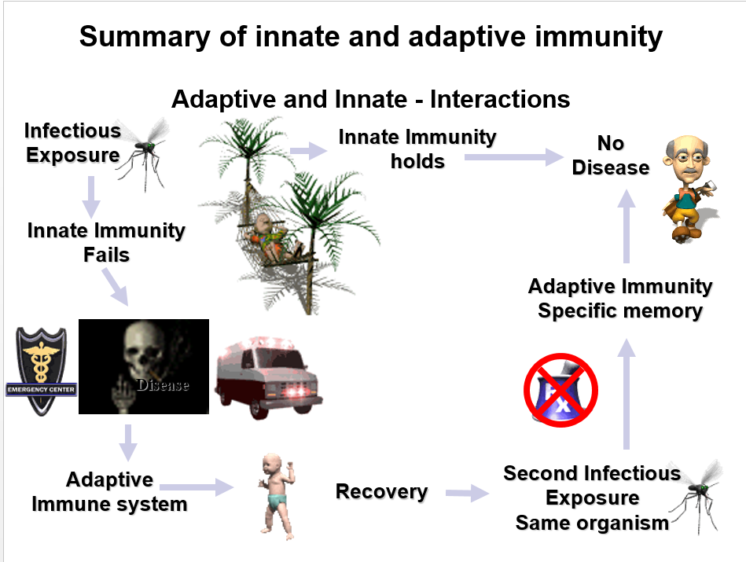

Slide 137
Passive immunity
This type of immunity is “borrowed” from another source, but it does not last indefinitely.
For instance, a baby receives antibodies from the mother through the placenta before birth and in breast milk following birth.
This passive immunity protects the baby from some infections during the early years of their life.

Slide 138
Assignment
Read and make notes on the history of immunology

Slide 139
THANK YOU

